Slide 1
Lending Club
How to Get a Loan: An Exploration with Logistic Regression
By Tianhong Ding & William Raikes

Slide 2

“Lending Club’s platform has the potential to profoundly transform traditional banking over the next decade.”
- Larry Summers, Former US Treasury Secretary
“The math pitch involves the increased efficiency of cutting out the banks, allowing relatively lower rates for borrowers and good returns for lenders.”
- New York Times
What is the lending Club?
DESCRIPTION:
A peer-to-peer lending company, headquartered in San Francisco, California and founded in 2006.
The world’s largest online credit marketplace, facilitating personal loans, business loans, medical financing, etc.
Loans funded to date: over $22 billion.
HOW IT WORKS:
Potential customers complete brief application online.
Lending Club digitally assesses the risk, credit rating and interest rates, and then sends qualified applicants an offer.
Investors ranging from individuals to institutions select loans in which to invest.

Slide 3
Data Descriptions
How to Get a Loan
Variable | Description | Notes
Status | Granted a Loan or Rejected | Outcome Variable
Loan Amount | Amount Requested by Applicant | Full Amounts are Usually Granted
Date | Date of Application or Loan Granted | ~ 7 Days Difference
Debt-to-Income Ratio (DTI) | Monthly Debt Payments / Monthly Income | Excludes Mortgage
Employment Length | Employment Length in Years
State | State
Zip Code | Zip Code
Notes:
3

Slide 4
How to Get a Loan
Inference: Which Factors Matter Most?

Slide 5
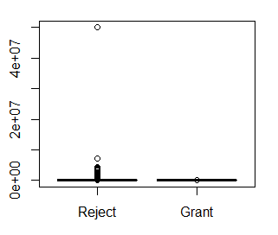
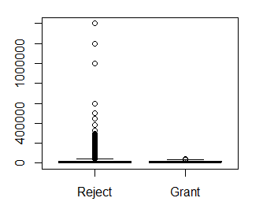
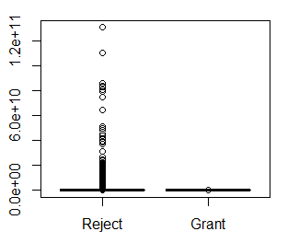
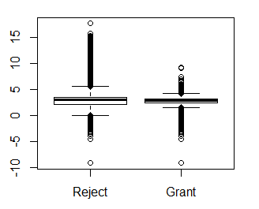
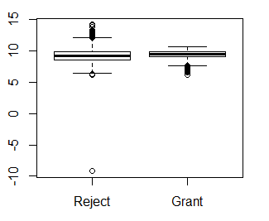
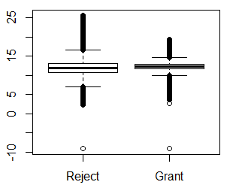
Exploratory Data analysis: Numerics
How to Get a Loan
Interaction
(DTI x Loan Amount)
Original
DTI
Loan Amount
< 1%
< 1%
Log
< 1%
Notes:
5

Slide 6
Exploratory Data analysis: categoricals
How to Get a Loan
Employment Length
Month
Year
< 1 year
1 year
2 years
3 years
4 years
5 years
6 years
7 years
8 years
9 years
10+ years
Jan
Feb
March
April
May
June
July
Aug
Sept
Oct
Nov
Dec
2007
2008
2009
2010
2011
2012
2013
2014
2015
2016
Notes:
6

Slide 7
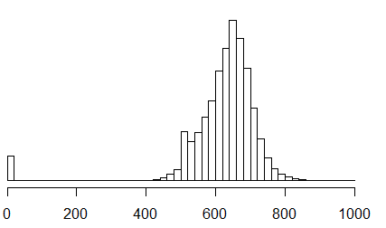
Exploratory Data analysis: confounder
How to Get a Loan
A Confounder: FICO Score Among Rejection Sample
Average National FICO Score: 695
Notes:
7

Slide 8
Fitting A Logistic Regression (LOGIT)
How to Get a Loan
Model
Granted Loan = Intercept + B₁(DTI) + B₂(Loan Amount) + B₃(Interaction) + B₄(Year) + B₅(State) + B₆(Employment) + B₇(Month)
Multicollinearity
Goodness of Fit
LR Test - Interaction Term: p-value < 0.001
McFadden’s R2: 0.503
 | VIF
DTI | 2.02
Loan Amount | 2.36
Interaction | 3.41
Year | 1.55
State | 1.06
Employment Length | 1.18
Month | 1.41
Influential Points (Cook’s Distance)
Zero data points with D_{i} > 1.
~7% of data points with D_{i} > 4/n
Removing influential pts. decrease AIC by 6.3%.
Practical and statistical significance remain unchanged.
Notes:
8

Slide 9
Logistic Regression: Interpretation
How to Get a Loan
 | Coefficient | exp(B) | p-value | Interpretation
DTI | -0.0032 | 0.996 | < 0.001 | One unit increase in DTI decreases the odds-ratio by 0.4%. May seem small, but DTI unit can very (range is 0-9999 for grants).
Loan Amount | < 0.0001 | ~ 1.0 | 0.704 | The loan amount is not indicative of the probability of receiving a loan.
Interaction | < 0.0001 | ~ 1.0 | < 0.001 | The interaction term is statistically significant, but has a low effect size. Only large swings in interaction result in material changes to odds-ratio.
Notes:
9

Slide 10
Logistic Regression: Interpretation
How to Get a Loan
 | Coefficient | exp(B) | p-value | Interpretation
Employment (Baseline: < 1 years) | 1 year: 4.774 2 years: 4.832 3 years: 4.850 4 years: 4.980 5 years: 2.129 6 years: 4.898 7 years: 4.976 8 years: 5.039 9 years: 5.138 10+ years: 5.016 | 118.4 125.5 127.7 145.5 8.4 134.0 144.9 154.3 170.4 150.8 | < 0.001 < 0.001 < 0.001 < 0.001 < 0.001 < 0.001 < 0.001 < 0.001 < 0.001 < 0.001 | At least 1 year(s) worth of experience increases the odds-ratio to a factor of 118 to 170. This variable is crucial (both statistically and practically speaking). There’s an anomaly at year 5.
Month (Baseline: January) | Feb. 0.135 Mar. 0.286 Apr. 0.177 May 0.230 Jun. 0.180 Jul. 0.325 Aug. 0.310 Sep. 0.040 Oct. 0.478 Nov. 0.345 Dec. 0.021 | 1.1 1.3 1.2 1.3 1.2 1.4 1.4 1.0 1.6 1.4 1.0 | 0.004 < 0.001 < 0.001 < 0.001 < 0.001 < 0.001 < 0.001 0.469 < 0.001 < 0.001 0.661 | Seasonality plays a very small, almost trivial role in the chances of obtaining a loan. Although there is statistical significance, there is no practical significance.
Notes:
10

Slide 11
How to Get a Loan
Prediction: How Well Does it Perform?

Slide 12
Prediction
5 Fold Cross Validated ROC Metrics
(Means)
How to Get a Loan
XGBoost performs the best, with the highest ROC.
Random Forest comes in a close second.
Logistic Regression is not far behind.
Generalized Additive Model and LDA perform slightly worse.
XGBoost
Random Forest
Logistic Regression
Generalized Additive Model
Linear Discriminant Analysis
Notes:
12

Slide 13
How to Get a Loan
Validation: Did They Get it Right?

Slide 14
Fitting A Logistic Regression (again)
How to Get a Loan
Model
default = Intercept + B₁(DTI) + B₂(Loan Amount) + B₃(Year) + B₄(State)
+ B₅(Employment) + B₆(Month)
Multicollinearity
Goodness of Fit
McFadden’s R2: 0.033
ROC (Cross-Validated) 60.4%
 | VIF
DTI | 1.1
Loan Amount | 1.0
Year | 1.2
State | 1.1
Employment Length | 1.1
Month | 1.1
Influential Points (Cook’s Distance)
Zero data points with D_{i} > 1.
~6% of data points with D_{i} > 4/n
AIC drops 28%
McFadden’s R2 goes to 0.133
Coefficients still stay relatively the same
NOTE: Interaction term left out due to high multi-collinearity.
Notes:
14

Slide 15
Validation (directional)
Percentage Increase (Decrease) in Odds-Ratio for Likelihood to Default
How to Get a Loan
DTI*
Loan amount*
Debt-to-Income ratio seems to have a similar impact on default rate as it does to rejection status.
Employment length does have a negative impact on default rates.
Could be an opportunity for more loans to people with <1 & 5 years worth of employment (less than 1%, and 10%, of people in this category were granted loans respectively).
1 year*
2 years*
3 years*
4 years*
5 years*
6 years*
7 years*
8 years*
9 years*
10+ years*
Employment Length (Baseline: < 1 year)
* Indicates significant difference at 95% confidence level.

Slide 16
How to Get a Loan
Conclusion

Slide 17
conclusion
How to Get a Loan
Limitations
FICO is most likely a confounder. Obtaining this data would significantly improve the analysis.
How does one get a loan?
Have a job:
Be employed for at least 1 full year.
And if it’s 5 years, then lie.
Your odds-ratio increases by a factor of at least 118!
Be reasonable:
Debt-to-Income Ratio < 10,000 (likely automatic cap).
Requested Loan Amount <= $40,000.
Interaction (DTI * Loan Amt) < 249,725,025.
Increase your income, lower your debt (always sound advice).
untapped potential
Predictors do not accurately report default rates.
Consumers who have < 1 year of employment could be untapped potential (or the LC could be vetting wisely).
Notes:
17

Slide 18
How to Get a Loan
The End: Q&A

Slide 19
How to Get a Loan: Appendix

Slide 20
appendix
Additional Analysis
Employment Length
Hosmer-Lemeshow: Rejection Model
 | % Applied | % Have Loan
< 1 year | 74% | 8%
1 year | 1% | 7%
2 years | 2% | 9%
3 years | 2% | 8%
4 years | 1% | 6%
5 years | 8% | 7%
6 years | 1% | 5%
7 years | 1% | 5%
8 years | 1% | 5%
9 years | 1% | 4%
10+ years | 6% | 31%
Large sample: p-value < 0.001
Small sample: p-value 0.29
“As with any statistical test, the power increases with sample size; this can be undesirable for goodness of fit tests because in very large data sets, small departures from the proposed model will be considered significant.”
Standardizing the power of the Hosmer-Lemeshow goodness of fit test in large data sets (Paul, Pennel, Lemeshow, 2013).

